Slide 1



The clash in internal validity of medical prediction models: Bootstrap vs. cross-validation
A research proposal by Sofie van den Brand
Supervisors: Maarten van Smeden & Ben van Calster

Slide 2
Relevance & Background
Medical prediction models
Internal validation:
Bootstrap (Harrell, .632 & .632+)
Cross-validation (10-fold cv, 10x10-fold cv, LOOCV & LPOCV)
How to decide?
Notes:
Importance of the models; support medical decision making, we need them to be accurate!
essential in developing these models is internal validation, as it quantifies the optimism of apparent performance.

Slide 3
Research Question
Aim: To equip applied prediction modelers with general guidelines to decide which internal validation method should be used in their situation.
In which scenarios does cross-validation or bootstrapped validation outperform the other within medical prediction models for binary outcomes, in terms of discrimination and/or calibration?

Slide 4
Approach: motivating example
Real-life dataset – Ovary cancer (from KU Leuven)
Ethical consent is on its way
Research report
Insights into real dataset
Notes:
The eventual goal is to come up with the guide to help applied prediction modellers, so hands-on experience may be very useful in that regard.

Slide 5
Approach: simulation
Simulation- scenarios:
Prediction models (SVM, RF, NN and LR)
Dimensionality (6-60 predictors)
Effect sizes (?)
Event rate (0.02-0.5)
Sample size (?)
AUC & discrimination performance (?)
Notes:
Plan is to have some constant factors in there, so we reduce the amount of scenarios. Still in the process of

Slide 6
Ethical consent
Real-life dataset; has been used before.
Consent is being arranged as we speak
Simulation study based on parametric modelling

Slide 7
Appendix
Collins, G. S., Reitsma, J. B., Altman, D. G., & Moons, K. G. M. (2015). Transparent Reporting of a Multivariable Prediction Model for Individual Prognosis or Diagnosis ( TRIPOD ) The TRIPOD Statement. 211–219. https://doi.org/10.1161/CIRCULATIONAHA.114.014508
Morris, T. P., White, I. R., & Crowther, M. J. (2019). Using simulation studies to evaluate statistical methods. Statistics in Medicine, 38(11), 2074–2102. https://doi.org/10.1002/sim.8086
Steyerberg, E. W., Bleeker, S. E., Moll, H. A., Grobbee, D. E., & Moons, K. G. M. (2003). Internal and external validation of predictive models: A simulation study of bias and precision in small samples. Journal of Clinical Epidemiology, 56(5), 441–447. https://doi.org/10.1016/S0895-4356(03)00047-7
Steyerberg, E. W. (2019). Clinical Prediction Models. Statistics for Biology and Health. 2nd edition.
Van Calster, B., Nieboer, D., Vergouwe, Y., De Cock, B., Pencina, M. J., & Steyerberg, E. W. (2016). A calibration hierarchy for risk models was defined: From utopia to empirical data. Journal of Clinical Epidemiology, 74, 167–176. https://doi.org/10.1016/j.jclinepi.2015.12.005
van Smeden, M., Moons, K. G. M., de Groot, J. A. H., Collins, G. S., Altman, D. G., Eijkemans, M. J. C., & Reitsma, J. B. (2019). Sample size for binary logistic prediction models: Beyond events per variable criteria. Statistical Methods in Medical Research, 28(8), 2455–2474. https://doi.org/10.1177/0962280218784726

Slide 8
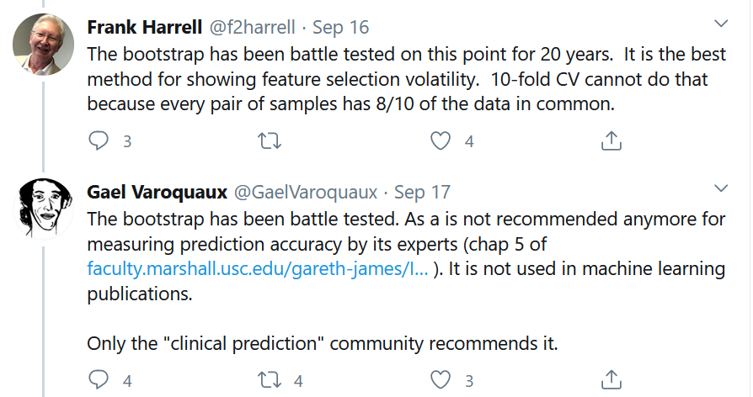

Twitter examples

